Slide 1


Motherson. Proud to be
part of the world’s most admired brands
MIS Report : LNJ-Skills
Motherson. Proud to be
part of the world’s most admired brands
Month- November’2019
MothersonSumi INfotech & Designs Ltd.
C-26, Sector-62, Noida, Uttar Pradesh

Slide 2
Overview
MSP Functions | Summary
Support & Remediation | Uptime & Utilization report ITSM SLA Report (Incident, Service Request and Change Request) Change Management & Service Request Report
Monitoring | Review of Current Monitoring Configuration Risks and Mitigation
Automated Cloud Management | List of scheduled reports
Management & Advisory | Cost and Capacity Optimization Recommendations Identity Management Report Architectural Review and Recommendations (Inventory details, architecture snapshot, recommendations as per Well Architected Framework) Patch Management Report Backup and DR Report

Slide 3
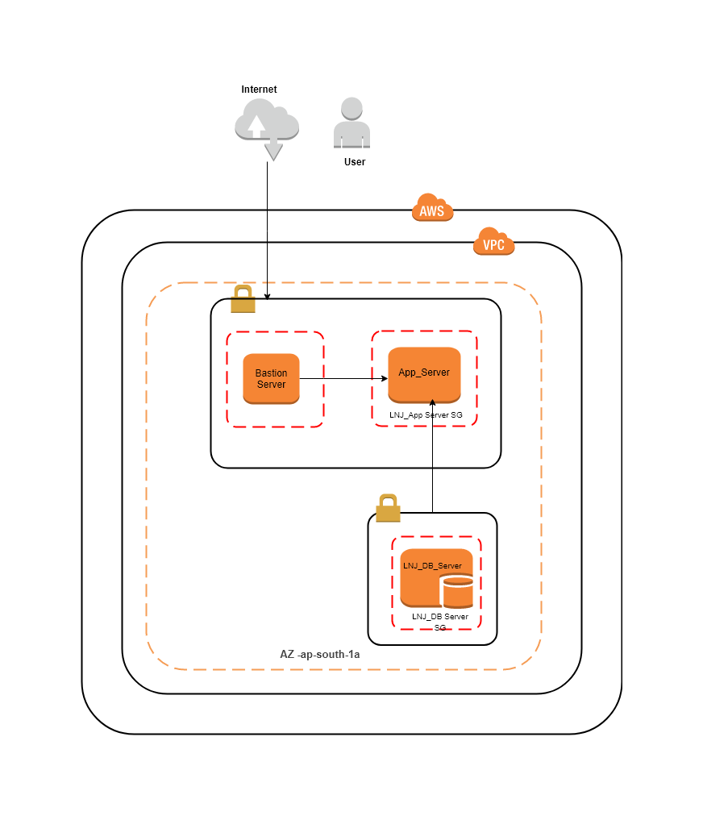
LNJ Architecture

Slide 4
Uptime & Utilization Report
Report Description and Key Highlights | Reports
Disk-Space Utilization for the Month of Nov 2019 with minimum/maximum and Average Percentage. | App Server DB Server Average : 9.64% Avg: 2.84% Min : 9.55% Min : 2.6% Max : 9.71% Max : 2.95%
CPU Utilization for the Month of Nov 2019 with minimum/maximum and Average Percentage | App Server DB Server Average : 1.08% Avg : 0.59% Min : 0.42% Min : 0.17% Max : 12.4% Max : 9.92%
Memory Utilization for the Month of Nov 2019 with minimum/maximum and Average Percentage. | App Server DB Server Average : 10.6% Avg: 24.8% Min : 2.52% Min : 23.8% Max : 67.8% Max : 25.7%
Key Highlights of the Report
Number of servers | 2
Servers Below 40% RAM utilization | 2
Servers Crossing RAM threshold of 85% | 0
Servers Crossing CPU threshold of 85% | 0
Servers Below 40% CPU utilization | 2

Slide 5
Security & Backup Monitoring Report
Security Patch : Most malware tries to compromise systems by using a known vulnerability that the operating system maker has already patched. As best practices to help prevent malware from affecting your systems, we should apply security patches.
We are waiting for your response to go ahead and update patches on production server.
Patches Update | Date | Approval
Patches update on App Server | 11-09-2019 | On-Hold
Patches Update on DB Server | 09-09-2019 | On-Hold
Backups of Application server | Daily at 10:30AM IST | Retention Days – 7
Backups of Database server | Daily at 4PM IST

Slide 6

Thank you!

